Slide 1
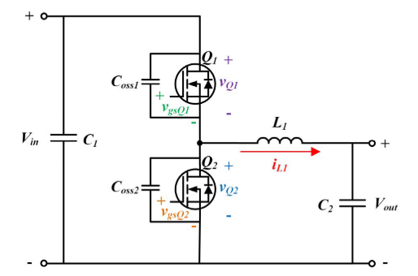
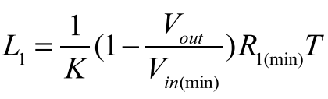

Synchronous Buck Converter with Zero-Voltage Resonant-Transition Switching
Simple Soft Switching
Additional passive and active components or a complicated loop control is not required
High conduction current due to high current ripple
Required condition for soft-switching:
Synchronous buck converter
K is proportional to input voltage
K is inv. prop. to maximum output current
The ratio between the peak-to-peak inductor current ripple and the average inductor current
Output load resitance
$$K∗t_{turn−off}=t_{turn−on}+t_{turn−off}$$
$$K=2 →t_{turn−on}=t_{turn−off}$$

Slide 2
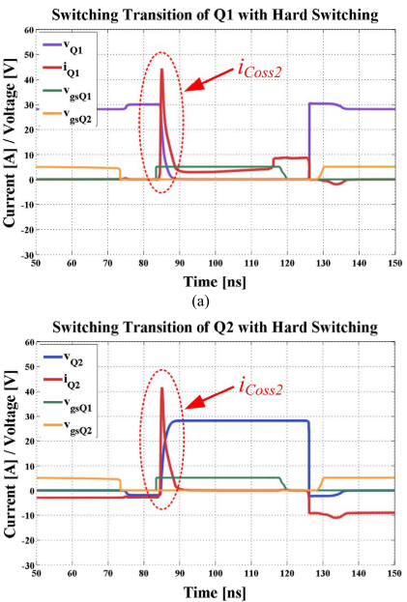
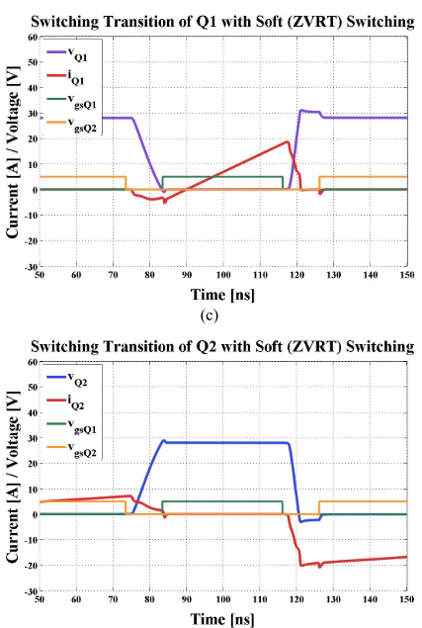
Spike on the switching current is removed
Unfortunately, the switching losses are still non-zero

Slide 3



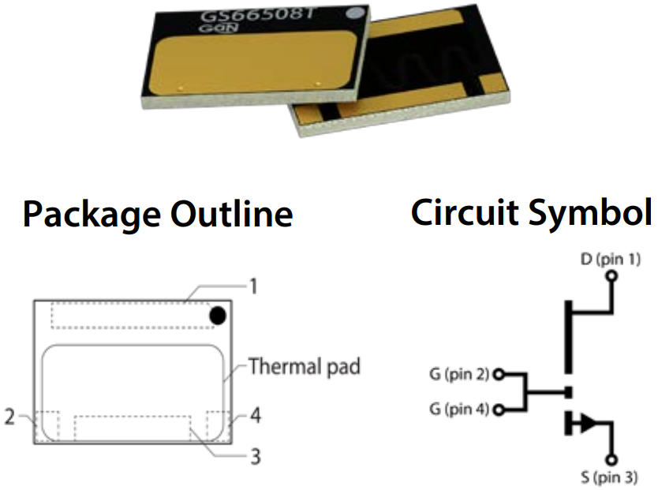
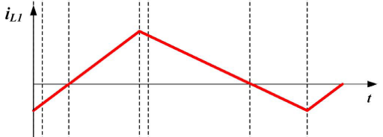
Loss Calculation
Transistor Parameters
GS66508T
650V / 30A
Top Cooling
Rds-on (150˚C) -> 129 mΩ
Coss -> 88 pF
DC
AC
Average Transition Time
Inductor Current

Slide 4
Loss Analysis
Vin = 540V
Vout = 400V
Iout = 20A
Pout = 8 kW
K = 4
Rise Time = 10 nsec
4 Parallel Transistor
3 Parallel Transistor

Slide 5
Loss Analysis
Vin = 540V
Vout = 400V
Iout = 10A
Pout = 4 kW
K = 4
Rise Time = 10 nsec
4 Parallel Transistor
2 Parallel Transistor

Slide 6
Loss Analysis
Vin = 220V
Vout = 150V
Iout = 20A
Pout = 3 kW
K = 4
Rise Time = 10 nsec
4 Parallel Transistor
3 Parallel Transistor

Slide 7
Loss Analysis
Vin = 220V
Vout = 150V
Iout = 10A
Pout = 1.5 kW
K = 4
Rise Time = 10 nsec
4 Parallel Transistor
3 Parallel Transistor

Slide 8
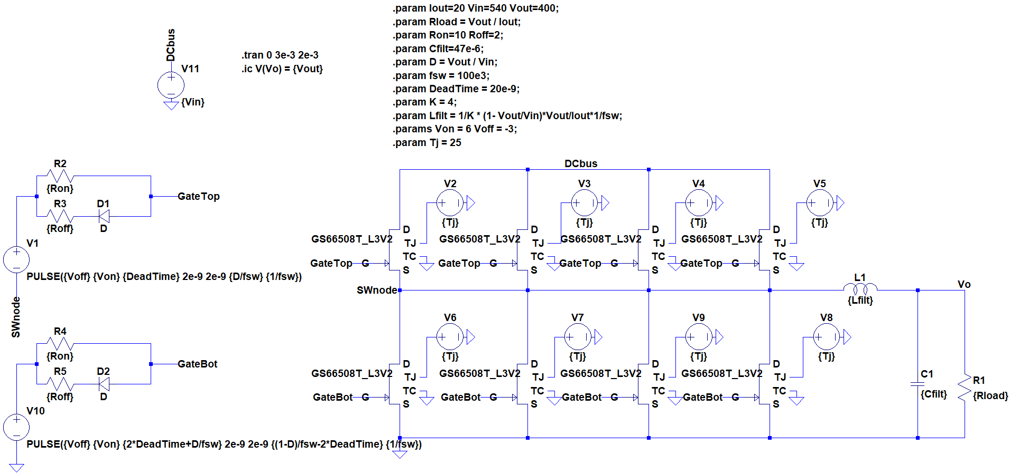
Simulation Study

Slide 9
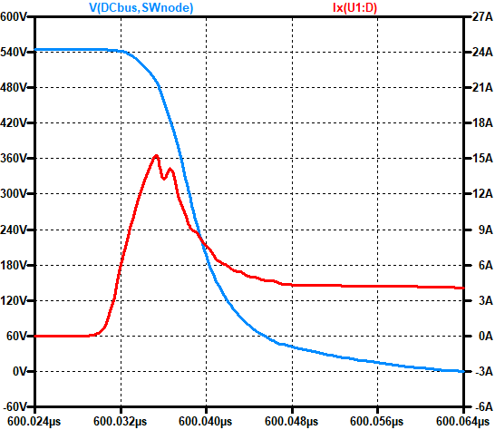
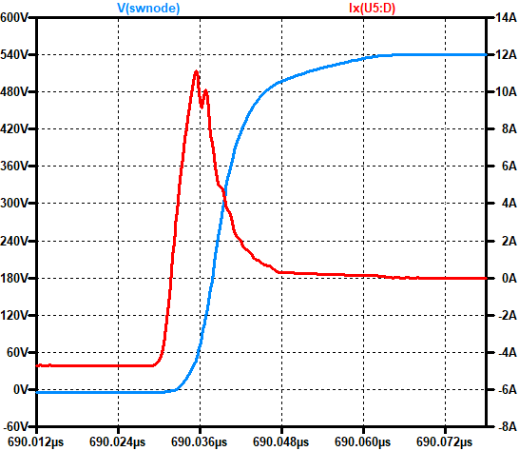
K = 0.25 -> No synch. switch Vin = 540V
Vout = 400V, Pout = 8 kW
fsw = 100 kHz, Tj = 25˚C
Simulation Study
4 App Ripple
Top Switch
Bottom Switch
Power Loss 7.1296 W
Power Loss 0.432 W
Total Transistor Loss = 30.2464 W

Slide 10
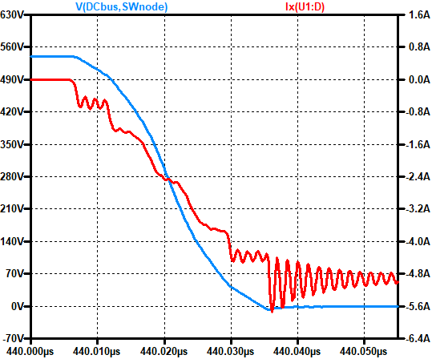
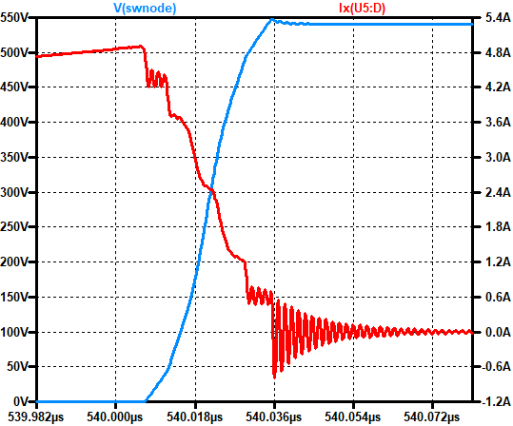
K = 4 -> Synch. switch Vin = 540V
Vout = 400V, Pout = 8 kW
fsw = 100 kHz, Tj = 25˚C
Simulation Study
80 App Ripple
Top Switch
Bottom Switch
Power Loss 2.2542 W
Power Loss 0.979 W
Total Transistor Loss = 12.9328 W
%57

Slide 11
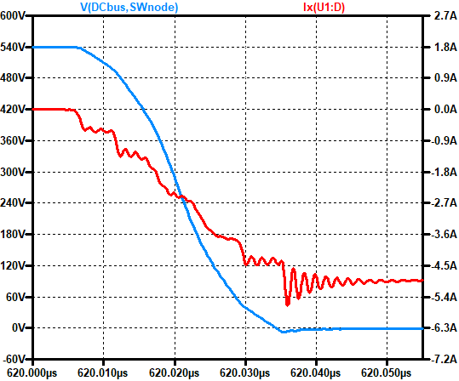
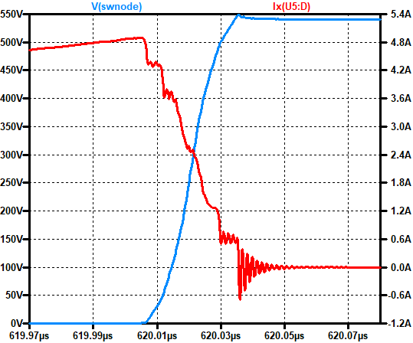
K = 4 -> Synch. switch Vin = 540V
Vout = 400V, Pout = 8 kW
fsw = 100 kHz, Tj = 125˚C
Simulation Study
80 App Ripple
Top Switch
Bottom Switch
Power Loss 5.3075 W
Power Loss 2.1791 W
Total Transistor Loss = 29.9464 W
%37

Slide 12
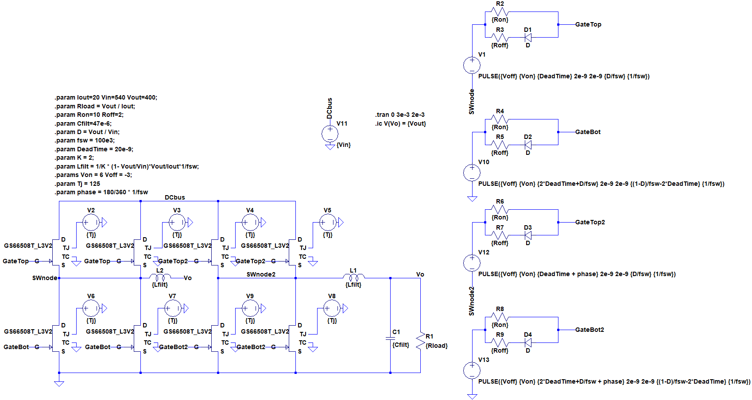
Simulation Study
Seperated Switching Nodes for Interleaving

Slide 13


Simulation Study
Advantages of Interleaved Half-Bridges for ZVRT Switching Buck Converter Application
The average output current is shared between two inductors which reduces average inductor current
Having less average inductor current requires less ripple current (K *Iavg)
Applying 180˚ phase shift between two half-bridges reduces stress over output capacitor significantly
What we get from interleaving
$$I_{L_{avg}}=20 A →I_{L_{avg}}^{∗}=10 A$$
$$I_{L_{pp}}=80 App →I_{L_{pp}}^{∗}=40 A$$
$$I_{C_{pp}}=80 App @ 100 kHz →I_{C_{pp}}^{∗}=26 App @ 200 kHz$$

Slide 14
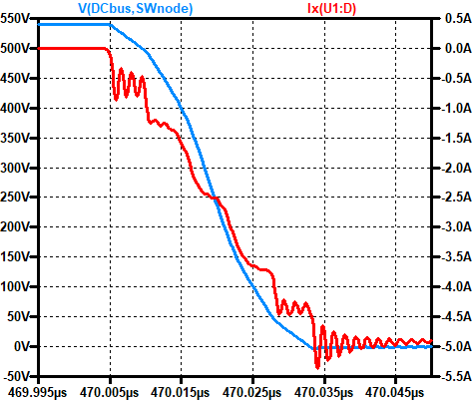
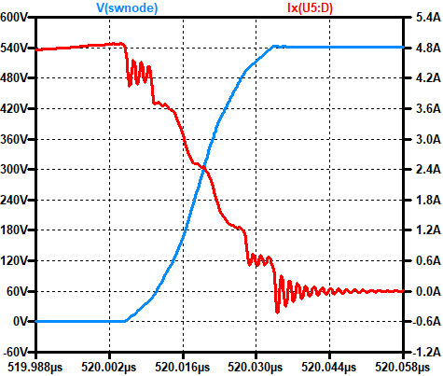
K = 4 -> Synch. switch Vin = 540V
Vout = 400V, Pout = 8 kW
fsw = 100 kHz, Tj = 125˚C
With Interleaving
Simulation Study
26 App Ripple @ 200 kHz
Top Switch
Bottom Switch
Power Loss 5.2144 W
Power Loss 2.0775 W
Total Transistor Loss = 29.1676 W
%15

